Slide 1
LINE FOLLOWING ROBOT

Slide 2
LINE FOLLOWING ROBOT
A course project report submitted in a partial fulfillment of the requirement
of smart system design
SMART SYSTEM DESIGN
by
K.THARUNCHARY (2203A51486)
S.CHARNYADAV (2203A51518)
T.SATVIKA (2203A51523)
T.SREE HARSHITHA (2203A51522)
Under the guidance of
Mr.P. RAMCHANDHAR RAO,
Asst. Prof., Department of ECE
DR.SUMITH GUPTHA ,
Asst. Prof., Department of ECE

Slide 3

ABSTRACT
Line Following is one of the most important aspects of robotics. A Line Following Robot is an autonomous robot which is able to follow either a black line that is drawn on the surface consisting of a contrasting color. It is designed to move automatically and follow the line. The robot uses arrays of optical sensors to identify the line, thus assisting the robot to stay on the track. The array of four sensor makes its movement precise and flexible. The robot is driven by DC gear motors to control the movement of the wheels. The Arduino Uno interface is used to perform and implement algorithms to control the speed of the motors, steering the robot to travel along the line smoothly.This project aims to implement the algorithm and control the movement of the robot by proper tuning of the control parameters and thus achieve better performance.In addition the LCD interface is added in order to display the distance travelled by the robot. It can be used industrial automated equipment carriers, small household applications, tour guides in museums and other similar applications, etc

Slide 4
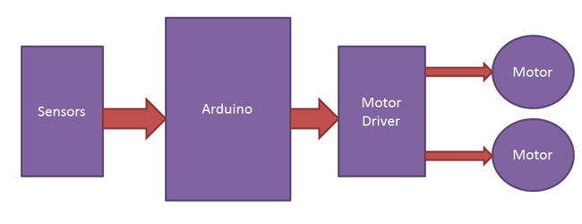
BLOCK DIAGRAM

Slide 5
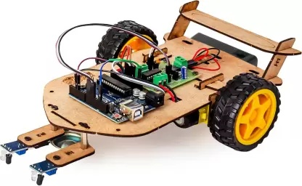
HARDWARE DESCRIPTION
Arduino Uno
IR sensor
L293D
motor driverBO
motorWheels
Lithium-ion battery
Jumper cables

Slide 6
Brief details of hardware
Sensors (IR Sensor): We have used IR Sensor Module as the line detecting sensor for the project. It consists of an IR LED and a Photo diode and some other components like comparator, LED etc.
Controller (Arduino UNO): Arduino UNO is the main controller in the project. The data from the sensors (IR Sensors) will be given to Arduino and it gives corresponding signals to the Motor Driver IC.
Motor Driver (L293D): L293D Motor Driver IC is used in this project to drive the motors of the robot. It receives signals from Arduino based on the information from the IR Sensors.
Motors (Geared Motors): We have used two geared motors at the rear of the line follower robot. These motors provide more torque than normal motors and can be used for carrying some load as well.

Slide 7
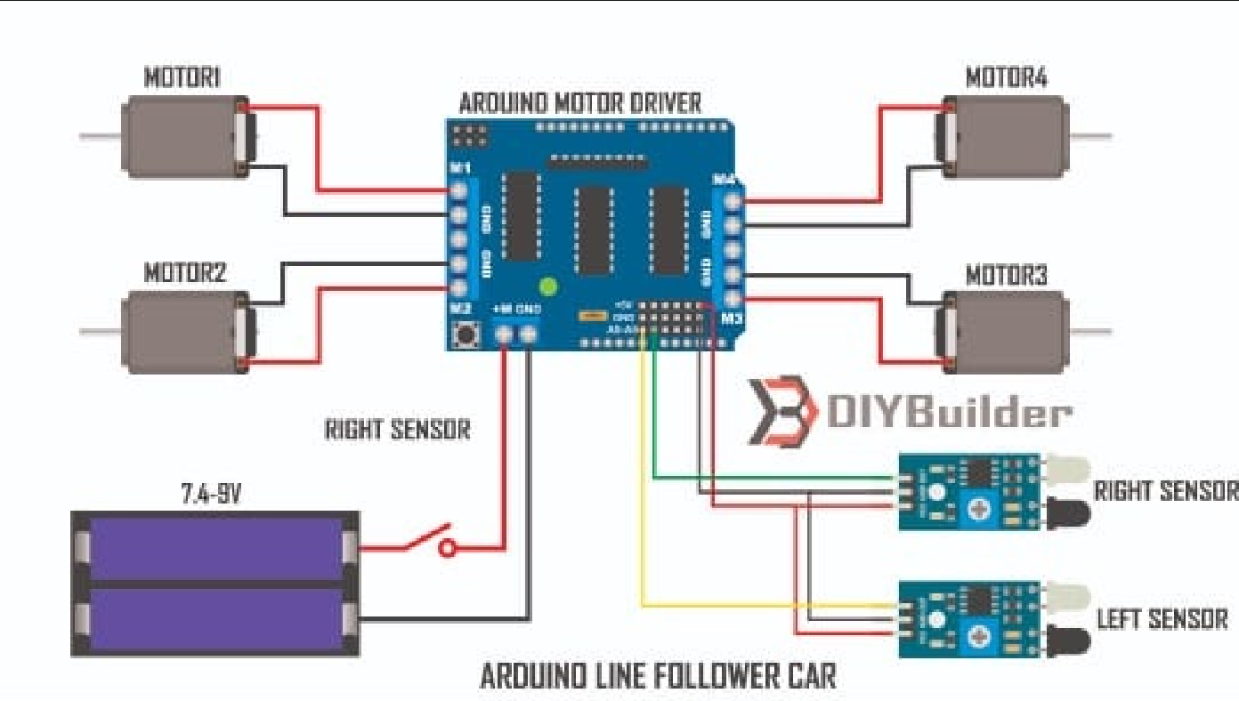
CIRCUIT DIAGRAM

Slide 8
RESULTS
The concept of the line follower robot is related to light. Here, we use the behaviour of light on the black and white surface. The white colour reflects all the light that falls on it, whereas the black colour absorbs the light.
In this line follower robot, we use IR transmitters and receivers (photodiodes). They are used to send and receive the lights. When IR rays fall on a white surface, it is reflected towards IR receiver, generating some voltage changes.
When IR rays fall on a black surface, it is absorbed by the black surface, and no rays are reflected; thus, the IR receiver doesn’t receive any rays.
In this project, when the IR sensor senses a white surface, an Arduino gets 1 ( HIGH ) as input, and when it senses a black line, an Arduino gets 0 ( LOW ) as input. Based on these inputs, an Arduino Uno provides the proper output to control the bot.

Slide 10
THANK YOU

